Slide 1

3666 ANLP
Predicting ECB Monetary Policy
Jonathan Fu
Fernando Espinosa
Shabnam Balamchi
Dec 16th/2023
Notes:
J

Slide 2
Outline
Project Overview
Challenges, Complexities and Use Cases
Process Flow
Exploratory Data Analysis (EDA)
Methods and Models
Next steps
Notes:
J

Slide 3


Project Overview: ECB Speech Analysis for Rate Change Prediction
Objective:
Predict ECB rate changes ("No Change," "Increase," or "Decrease") using speech text analysis.
Total speeches: 3,434
Date range: 1999–2023
Language: Majority in English
Key Question:
"How does speech content correlate with monetary policy decisions?“
Columns:
Speaker details (e.g., who, date, speech title).
Extracted text and term frequencies.
Monetary policy rate changes (% changes, direction).
Main Scope:
Data Analysis: Extraction and analysis of ECB speeches and press releases for predictive modeling.
Model Development: Building and fine-tuning a BERT-based vs LSTM vs Tree-based classification model for forecasting ECB rate changes.
Notes:
J

Slide 4
Challenges, Approaches, and Use Cases
Challenge | Impact | Approach/Technique
Class Imbalance | Minority classes ("Increase" & "Decrease") were underrepresented. Leads to poor performance. | Class Weights: Adjusted loss function. Manual Oversampling: Balanced training data. Tree-Based Models (XGBoost, LightGBM, CatBoost): Handled imbalance effectively with ensemble methods.
Semantic Complexity | Complex language made it challenging for simpler models. | BERT Fine-Tuning: Extracted semantic-rich features. Keyphrase Extraction for LSTM: Simplified inputs. Tree-Based Models: Captured complex patterns using gradient boosting.
Overfitting Risks | Deep learning models overfit due to small dataset size. | Early Stopping: Stopped training to prevent overfitting. Data Augmentation: Paraphrased existing data. Voting Classifier: Combined robust models to generalize better.
Corporate treasury management
(eg. lower borrowing costs)
FX, currency trading/hedging and Sovereign debt analysis
Optimize investment strategy and portfolio management
(eg. asset allocation)
Better risk management (eg. minimize the cost of interest rate hedging)
Examples

Slide 5
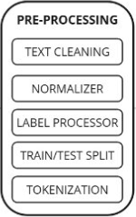


Process Flow
Title: Methodology Overview for ECB Rate Change Prediction
ECB Rate Changes Model
Data Collectionⁱ
Weblink Data
Speech Data ⁱⁱ
Rate Change Data ⁱⁱⁱ
No Change
Increase
Decrease
BERT vs LASTM vs Tree-based Model
ⁱ Screen-scraped ECB speeches and press releases using BeautifulSoup; tagged articles by dates between monetary policy decisions.
ⁱⁱ https://www.kaggle.com/datasets/robertolofaro/ecb-speeches-1997-to-20191122-frequencies-dm
ⁱⁱⁱ https://www.ecb.europa.eu/stats/policy_and_exchange_rates/key_ecb_interest_rates/html/index.en.html

Slide 6
Exploratory Analysis
Frequency Analysis: Understanding key terms and bigrams in the speeches.
Distribution Insights: Temporal and categorical patterns of the data.
Topic Modeling: Extracting dominant topics and their keywords using LDA.
Clustering Analysis: Visualizing clusters and validating using silhouette scores.

Slide 7
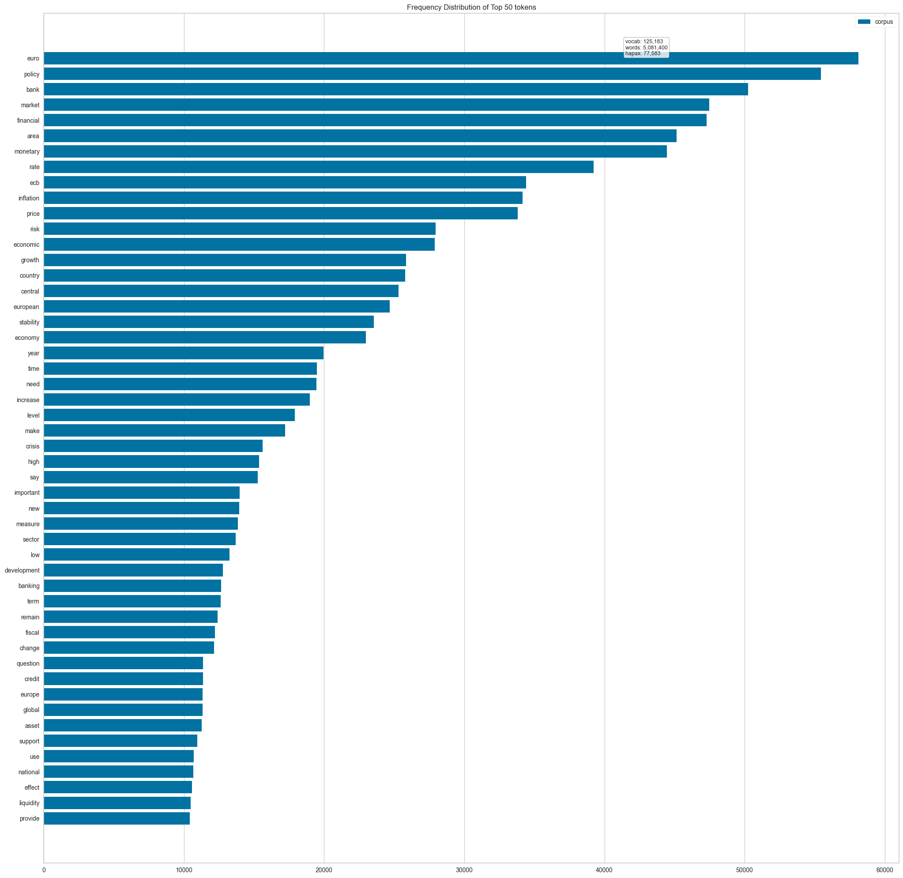
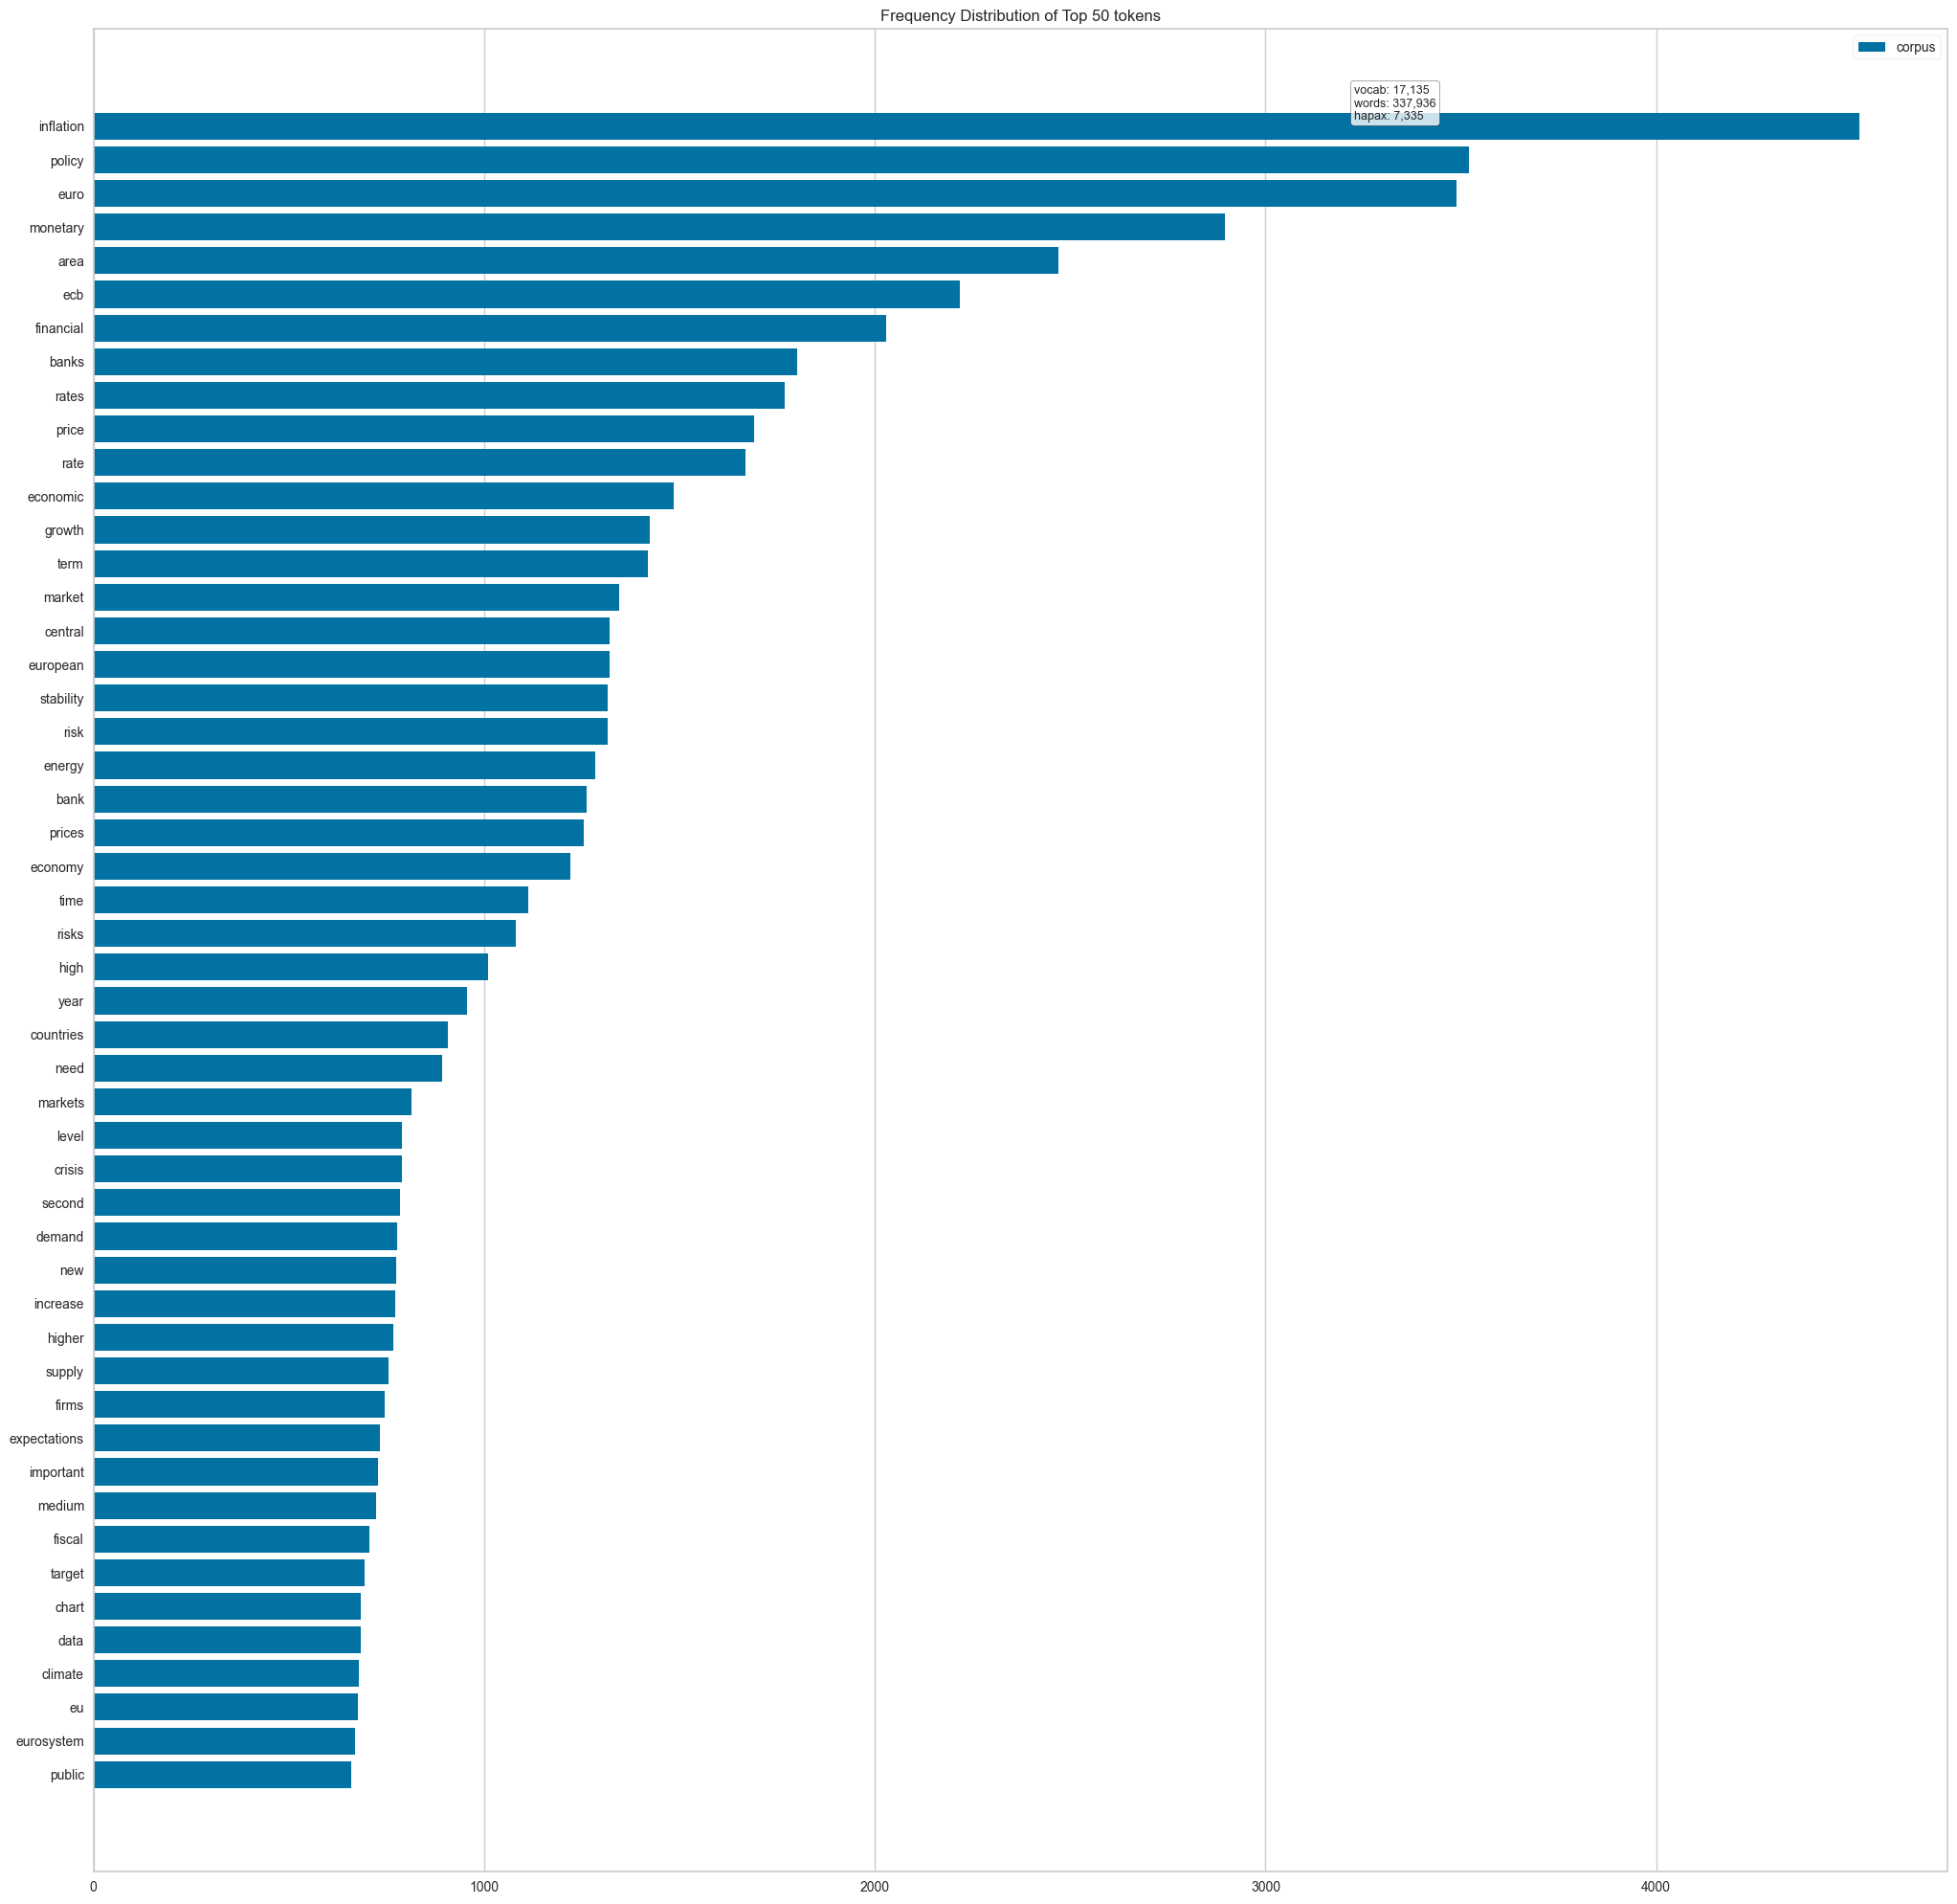
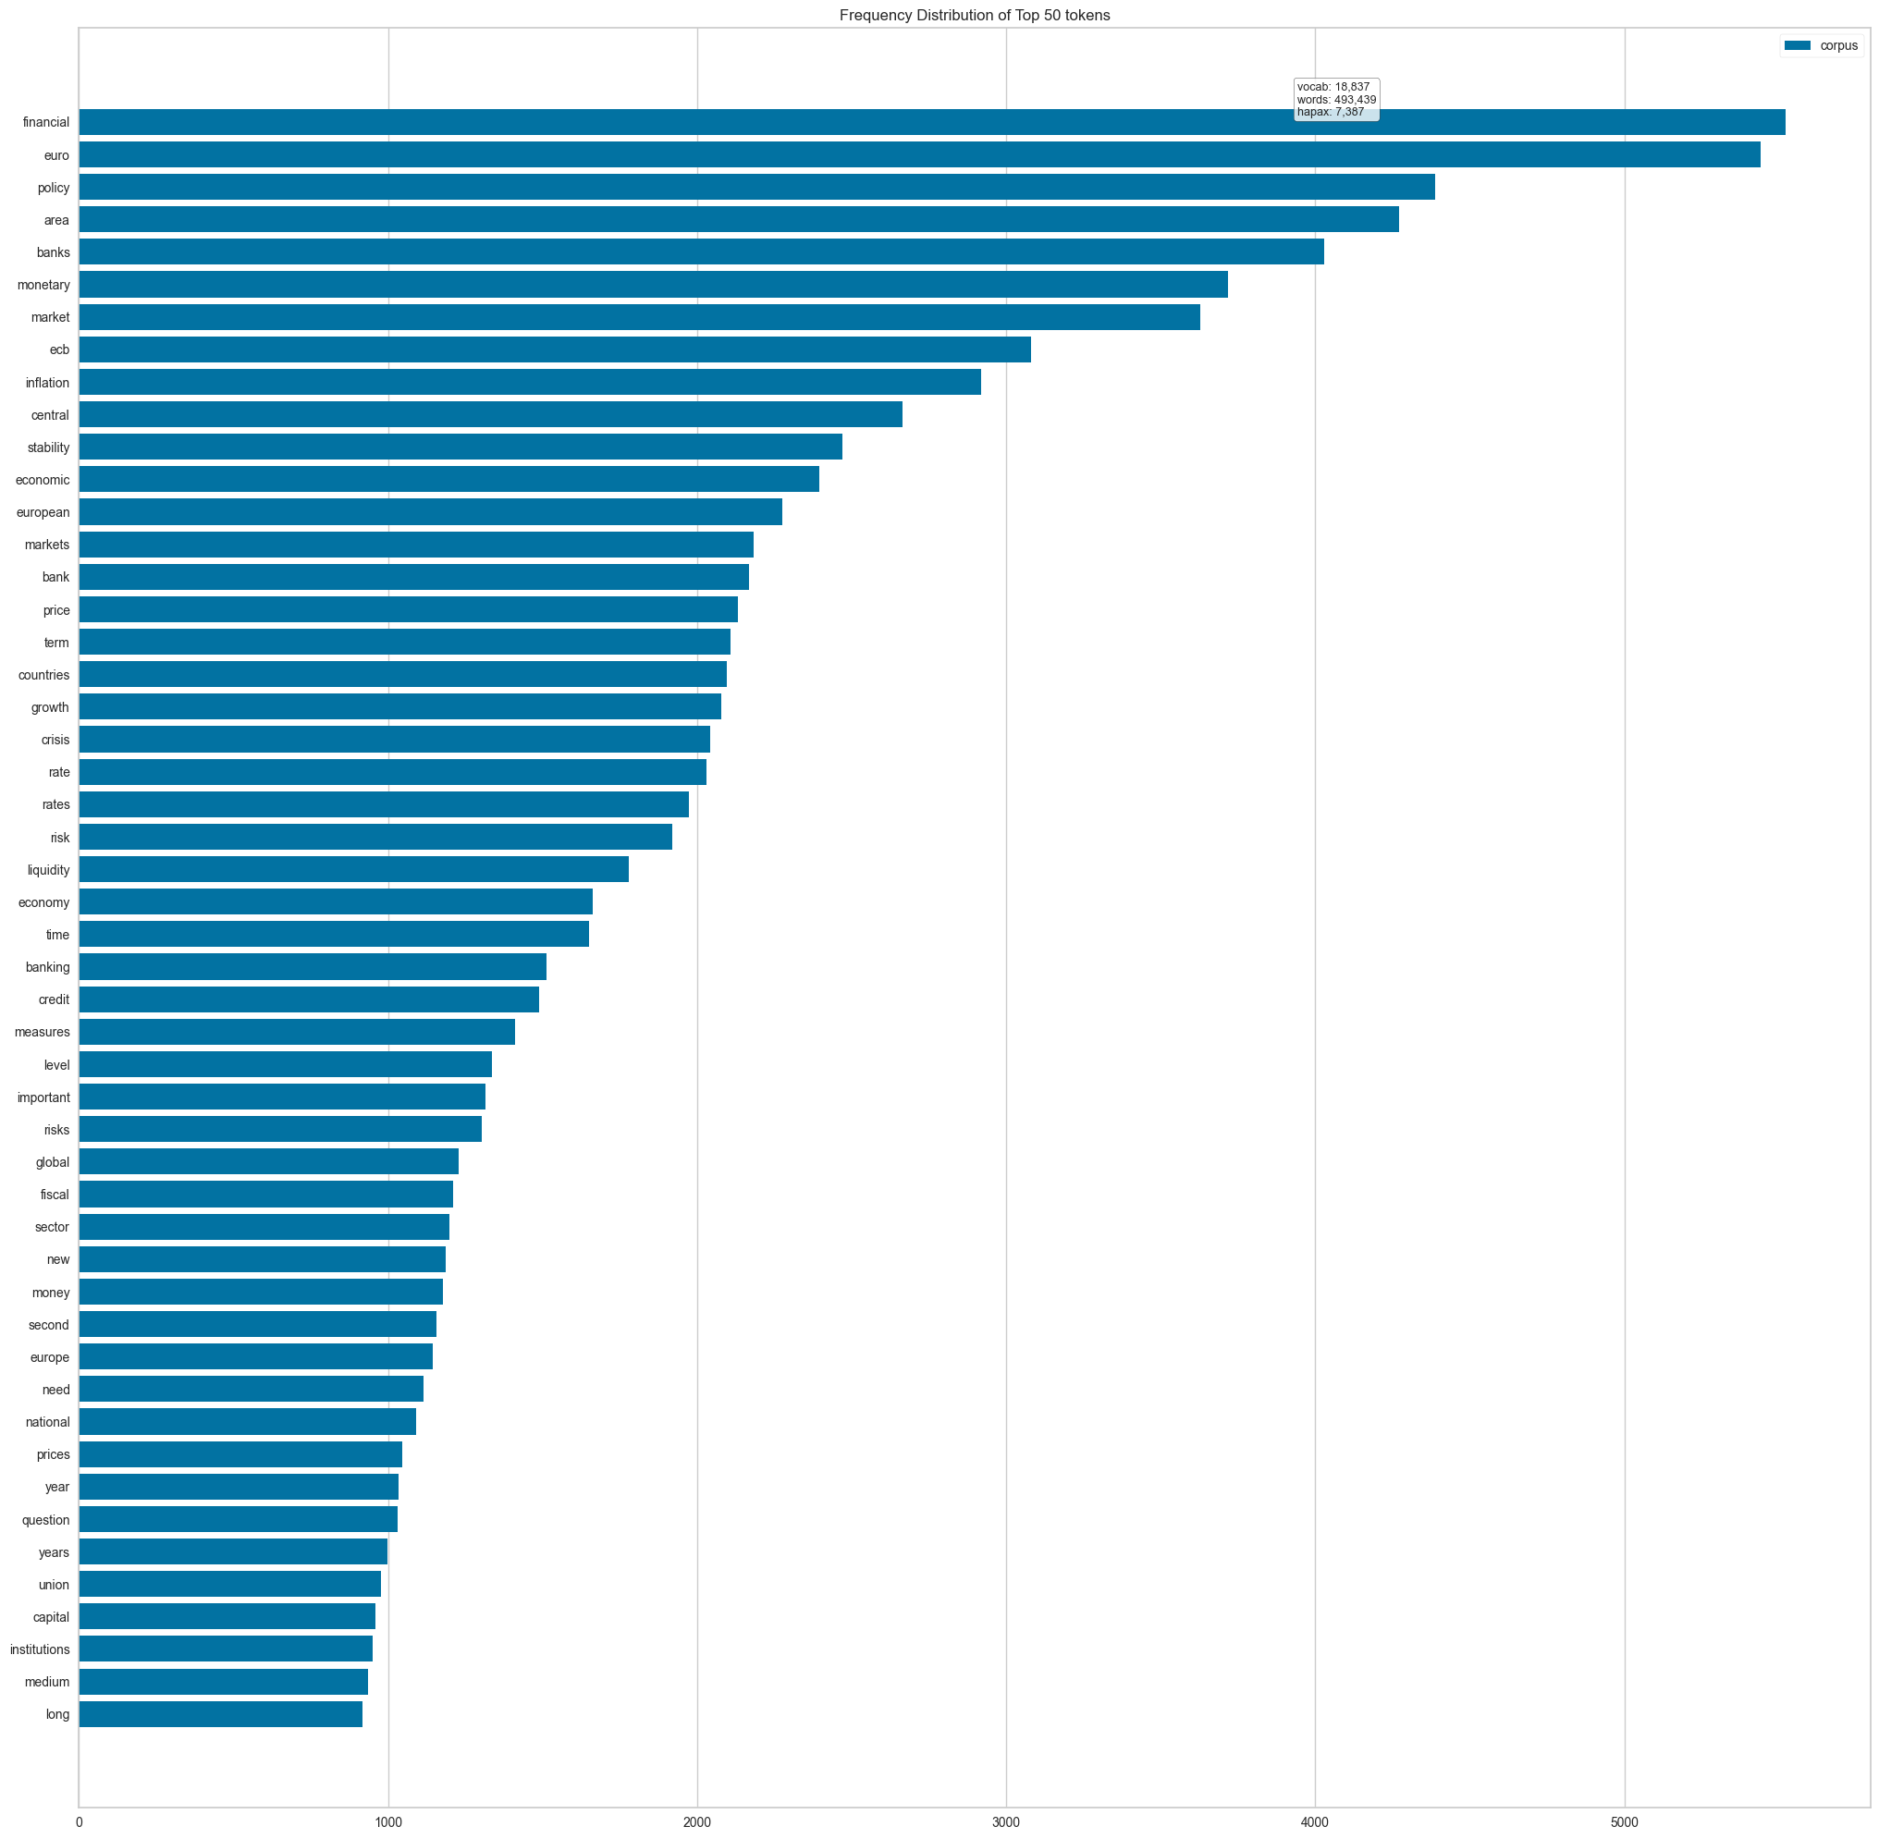
Frequency Distribution
Overall
Increase
Decrease

Slide 8
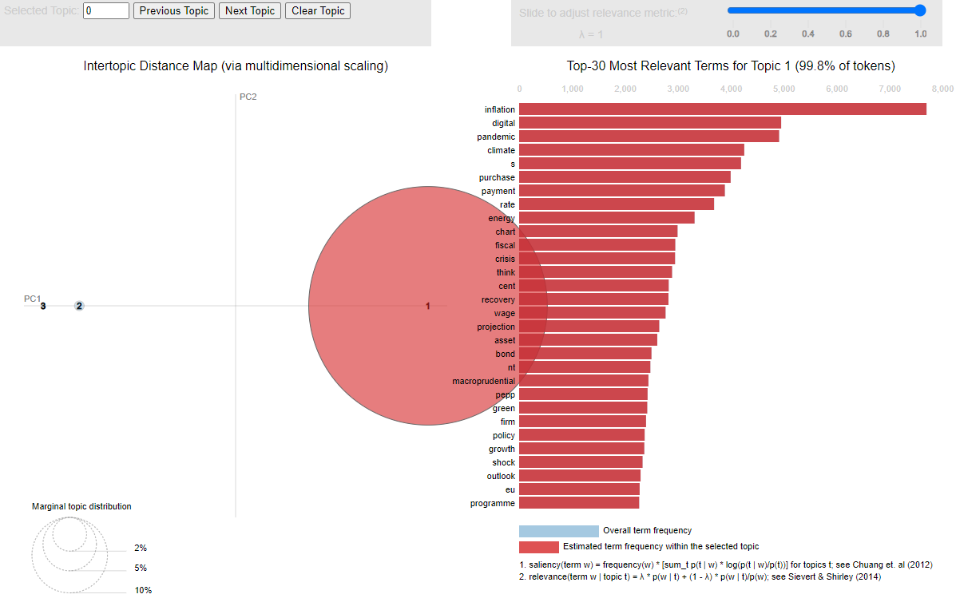
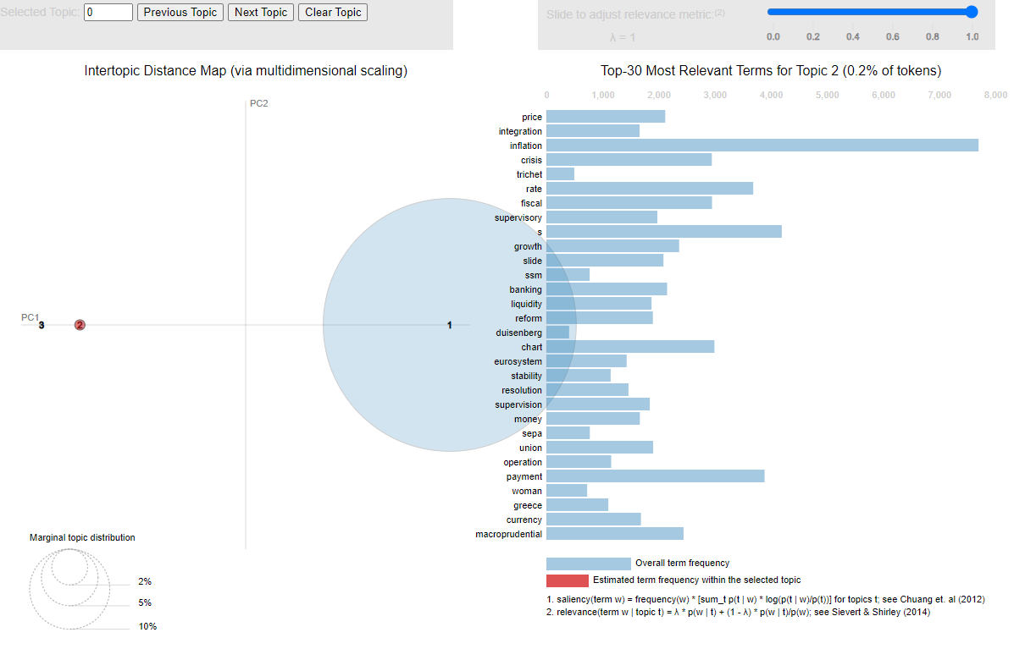
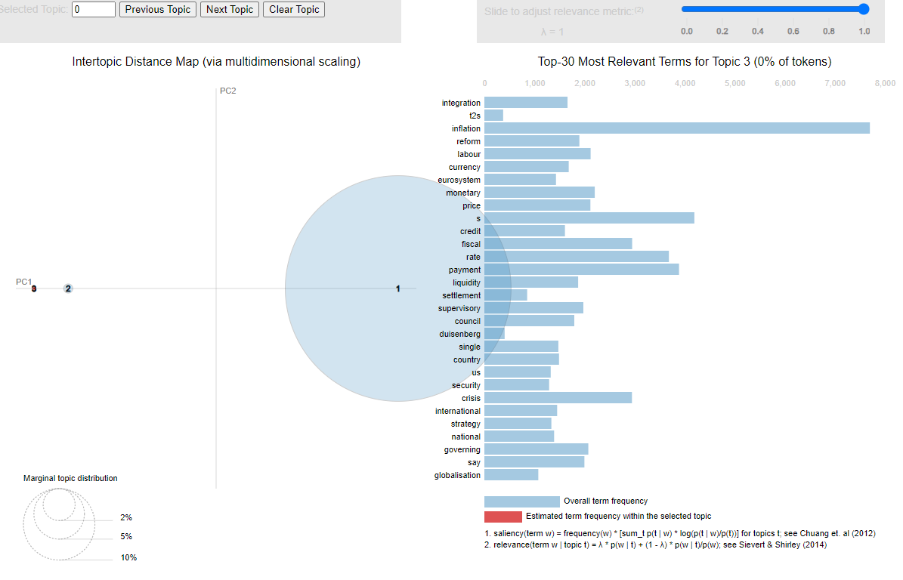
Key Topics in Speeches (Gensim LDA Visualization)
How ECB prioritizes its messaging in response to economic changes
Speeches cluster around 3–4 major themes:
Topic 1: Monetary policy, inflation, and price stability dominate discussions.
Topic 2: Digital euro and fiscal policy have emerged in recent years.
Topic 3: Broader economic growth and crisis-related topics.

Slide 9
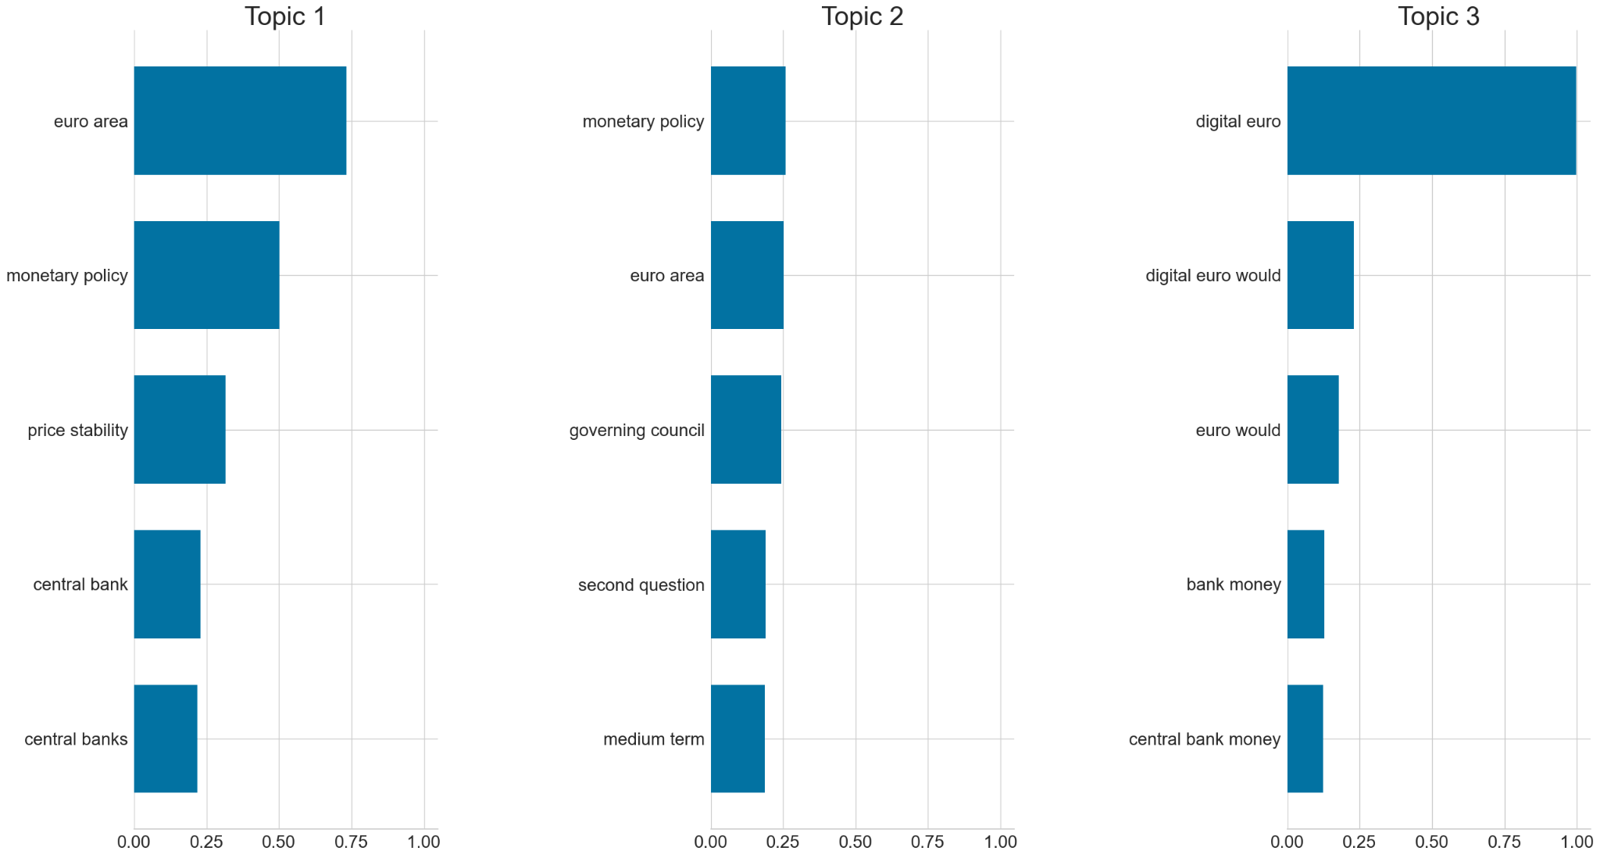
N-Grams
No significant difference between the overall topics vs. increase/decrease classes

Slide 10
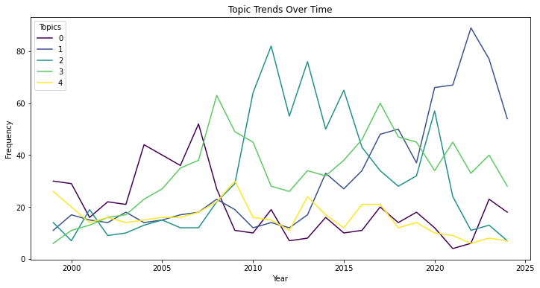
Temporal Trends in Topics
Digital euro and fiscal policy discussions have risen sharply since 2015.
Inflation and monetary policy remain consistently discussed across years.
This demonstrates how the ECB adapts its messaging to evolving economic conditions.
Topic 0 (financial growth and markets) saw a rise around 2010 but declined in prominence after 2015.
Topic 3 (economic and fiscal policy) peaked during the late 2000s, possibly reflecting responses to the 2008 financial crisis.
Topic 4 (central banking and risk management) had a steady focus, indicating its importance across different timeframes.

Slide 11
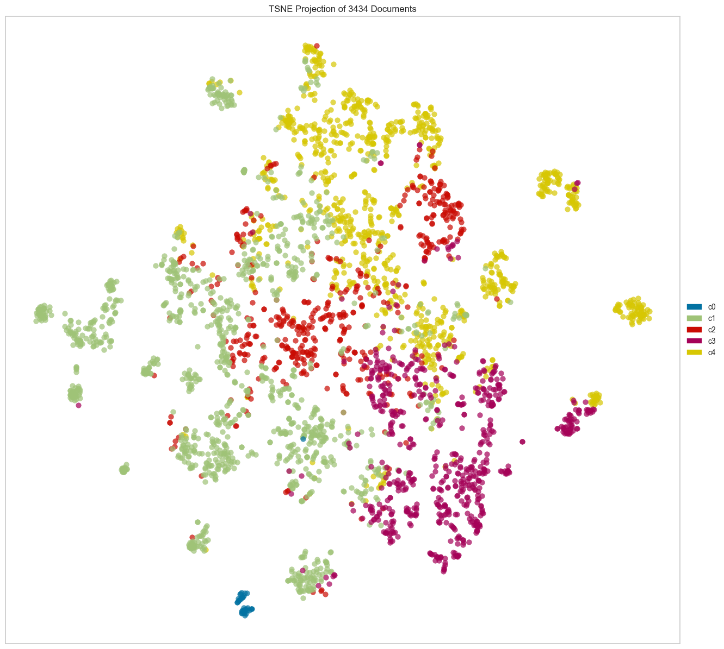
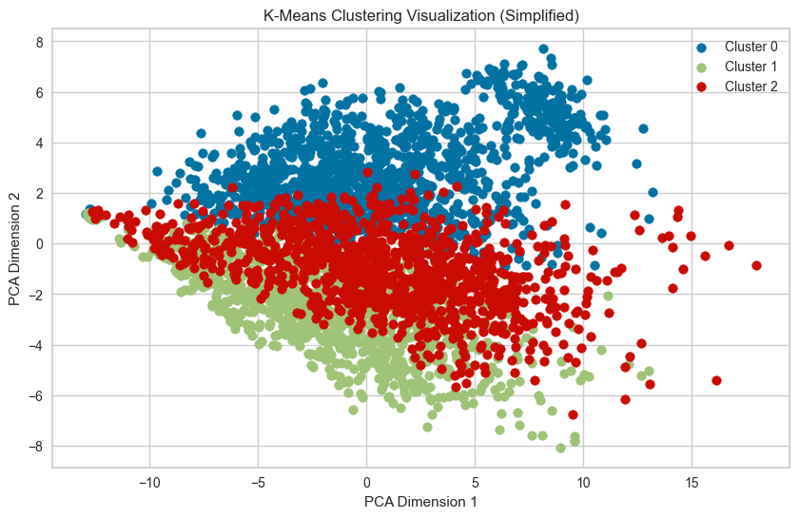
Unsupervised Cluster Analysis/t-SNE visualization
Best Clustering: The silhouette score is highest at k=2, indicating two dominant groupings or themes in ECB speeches.
Cohesion & Separation: k=2 provides the best balance between cohesion (within-cluster similarity) and separation (between-cluster distance).
Diminishing Returns: Lower scores for higher k suggest limited benefits from additional clusters, though finer nuances might still be captured.

Slide 12
Methods and Models
Metrics: F1-Score (Macro and Weighted), Precision and Recall, Confusion Matrix
Train/Eval split: 80/20 Test split: 20% held-out data to evaluate the final model.
BERT, LSTM, and Voting Classifier models
Classification Task: multiclass
Labels: No Change/Increase/Decrease
Model | Architecture | Size | Challenges Addressed
BERT | Transformer | Base | Semantic Complexity, Class Imbalance
LSTM | RNN | Base | Class Imbalance, Small Data Handling
Voting Classifier | Voting Classifier | Voting Classifier | Voting Classifier
* The Voting Classifier outperformed all other models by combining strengths of XGBoost, LightGBM, and CatBoost through weighted soft voting
Notes:
Metrics:
F1-Score (Macro and Weighted):
Macro F1-Score: Balances performance equally across all classes, ensuring minority classes are not ignored.
Weighted F1-Score: Averages F1-scores while considering class imbalances (weighting by class size).
Precision and Recall:
Precision: Measures how many predicted positive samples are correct.
Recall: Measures how many actual positive samples are correctly predicted.
These are critical for evaluating minority classes like "Increase" and "Decrease."
Confusion Matrix:
Provides a clear visualization of true positives, false positives, and misclassifications for each class.

Slide 13
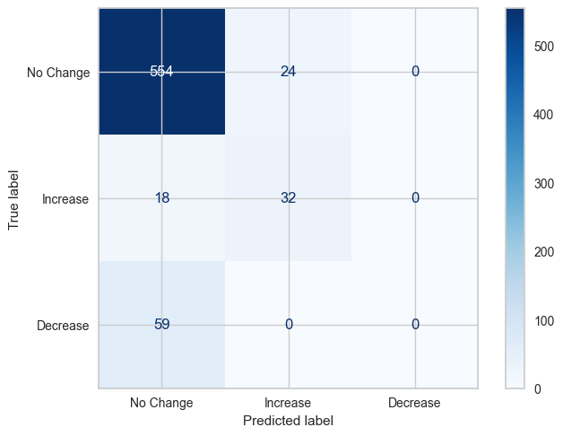
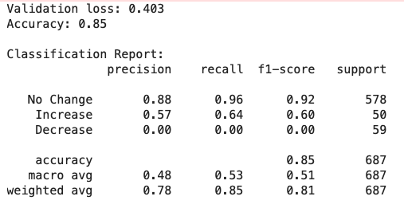
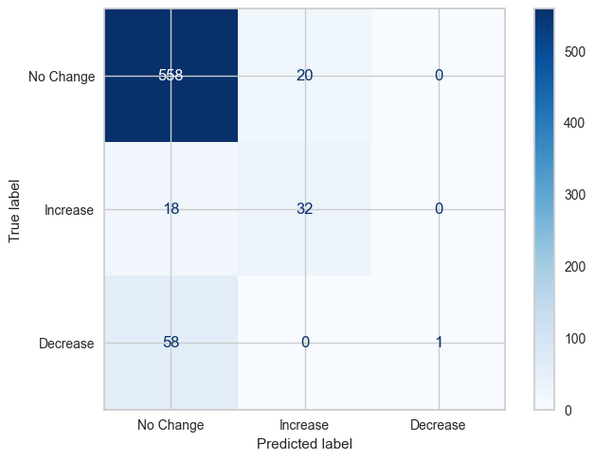
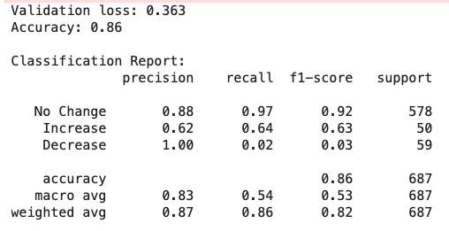
BERT
BERT - First 10 Epochs
BERT - 14 Additional Epochs

Slide 14
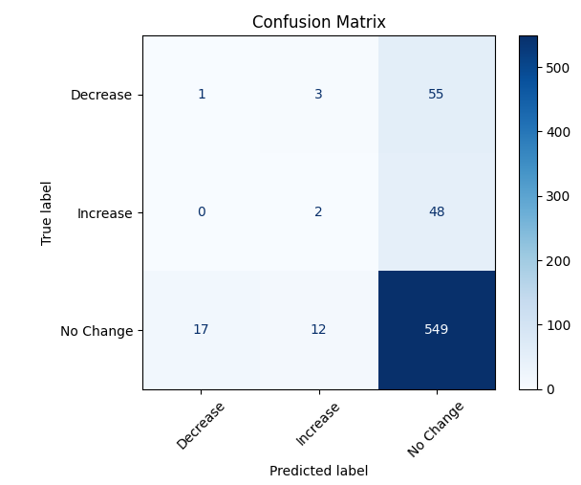
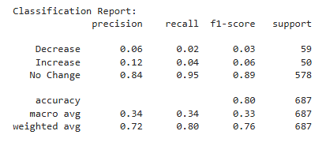
LSTM

Slide 15
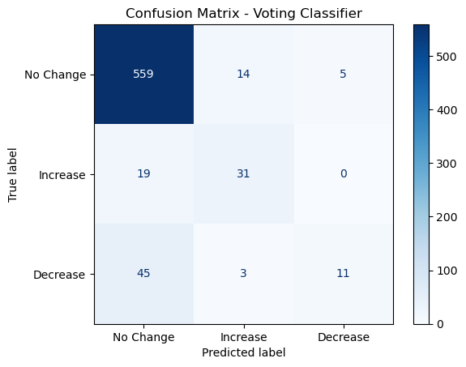
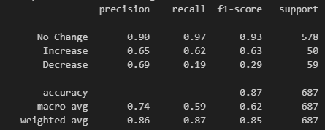
Voting Classifier: The Best Performing Model
Model | Macro Precision | Macro Recall | Macro F1-Score | Increase F1-Score | Decrease F1-Score | Comments
Logistic Regression | 0.57 | 0.68 | 0.61 | 0.57 | 0.39 | Good recall but lower precision.
XGBoost | 0.86 | 0.50 | 0.55 | 0.57 | 0.15 | High precision, poor recall for "Decrease".
LightGBM | 0.76 | 0.57 | 0.61 | 0.65 | 0.25 | Balanced but weak "Decrease" recall.
CatBoost | 0.61 | 0.62 | 0.60 | 0.58 | 0.32 | Best "Decrease" F1-score so far.
Voting Classifier | 0.79 | 0.59 | 0.62 | 0.63 | 0.29 | Best overall balance across metrics.
Challenges Addressed:
"Improved recall for minority classes (Increase/Decrease) and handled class imbalance effectively."
"Voting Classifier achieves the best trade-off between overall accuracy and minority class performance."

Slide 16
Why Tree-Based Models Performed Better? (possibilities)
Handling Imbalanced Data:
Tree-based models use class weights and ensemble methods to manage class imbalance effectively.
Small Dataset Suitability:
BERT and LSTM require large datasets; tree-based models generalize better with limited data.
Efficient Training:
Tree-based models are faster to train and less computationally intensive.
Feature Representation:
TF-IDF features work well with tree-based models, while embeddings (BERT/LSTM) are harder to optimize.
Interpretability:
Tree-based models provide clear feature importance insights.

Slide 17
Next Steps
Multi-Modal Model: Combine speech text with numerical/temporal data (e.g., historical rates, inflation) for richer predictions.
Enhance Minority Class Detection: Adjust decision thresholds and explore precision-recall trade-offs for Increase and Decrease classes.
Newer Transformer Models: Test models like FinBERT, RoBERTa, and DeBERTa for improved text understanding.
Improved Sampling: Use ADASYN and Cluster-Based Sampling for better handling of class imbalance.
Advanced Features: Use higher n-grams and combine TF-IDF with embeddings for better feature extraction.
Model Interpretability: Leverage tools like SHAP or LIME to explain model decisions and feature importance.

Slide 18
Q&A

Slide 19
Challenges and Complexities
Class Imbalance
The "Decrease“ & “Increase” classes were significantly underrepresented, leading to poor performance.
No Change 2,888 /Decrease 294 /Increase 252
Semantic Complexity
Speeches often contain complex language that makes it challenging for simpler models to capture nuances.
Overfitting Risks
Deep learning models like BERT and LSTM have a high capacity, increasing the risk of overfitting on a small dataset.

Slide 20
Approaches Employed:
Handling Class Imbalance:
Class Weights: Adjusted loss function to give higher weight to underrepresented classes.
SMOTE: Oversampling for minority classes to balance the dataset during training.
Improving Feature Extraction:
BERT Fine-Tuning: Leveraged a pre-trained transformer model to extract semantic-rich features from text.
Keyphrase Extraction for LSTM: Focused on domain-specific keywords to simplify input features.
Mitigating Overfitting:
Early Stopping: Stopped training when validation loss did not improve after a set number of epochs.
Data Augmentation: Simulated additional training examples by paraphrasing existing data.

